Slide 1
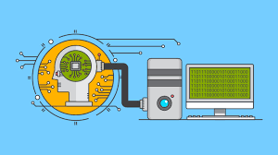
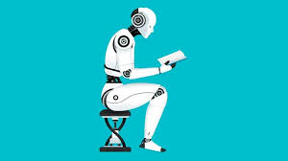
Machine Learning Techniques (16CSE09)
Unit – 1 / Session 2 & 3
20/01/2021

Slide 2
Unit – 1 / Sessions: 2 & 3
Course objective-1: Describe Various Machine Learning Approaches.
At the end of this session, students will be above to understand the various learning types and applications

Slide 3
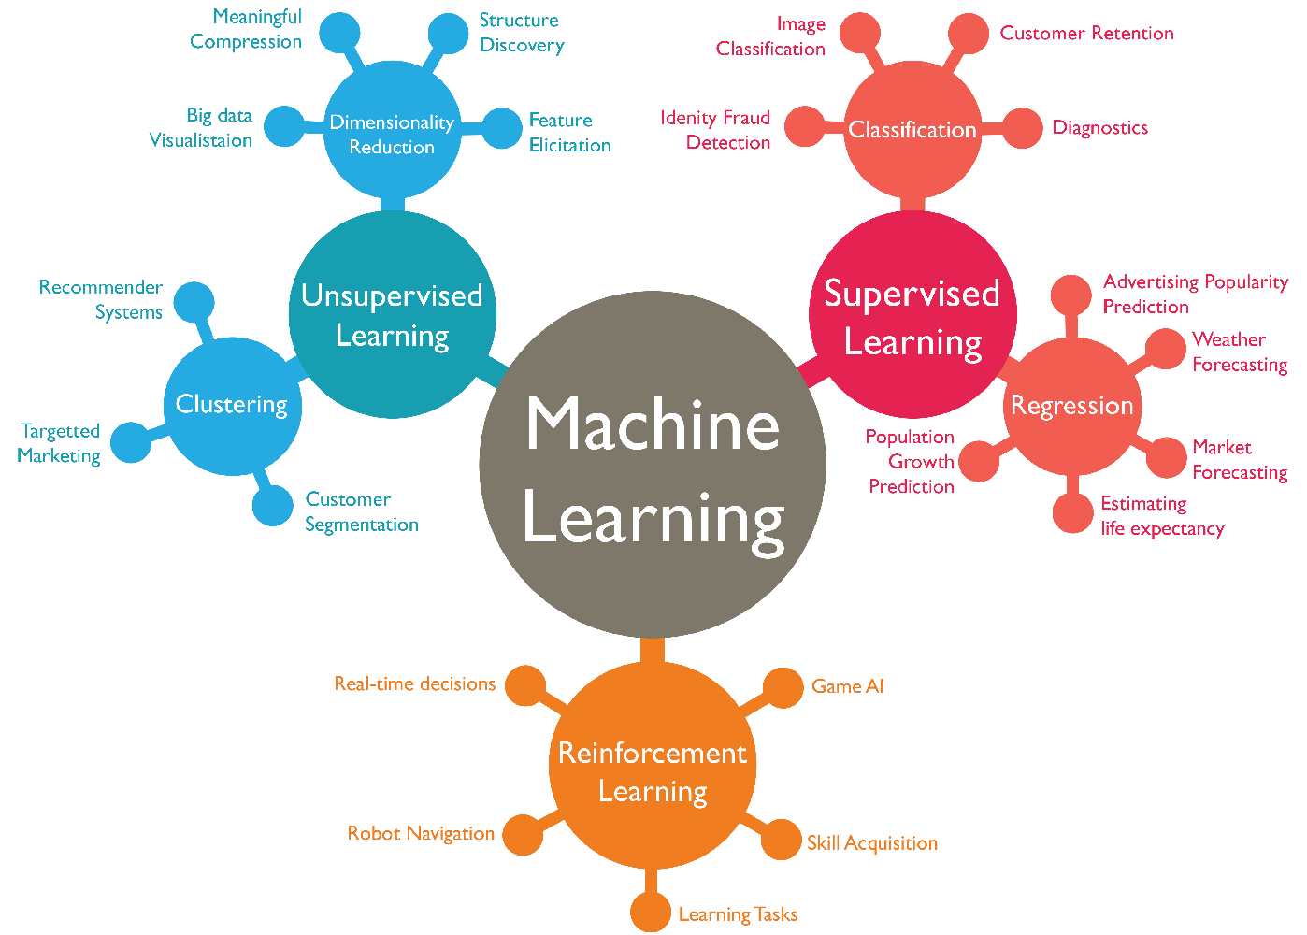

Slide 4
Machine Learning is…
A branch of artificial intelligence, concerned with the design and development of algorithms that allow computers to evolve behaviors based on empirical data.
past
future
learn
predict
Training
Data
model/
predictor
Testing
Data
model/
predictor

Slide 5
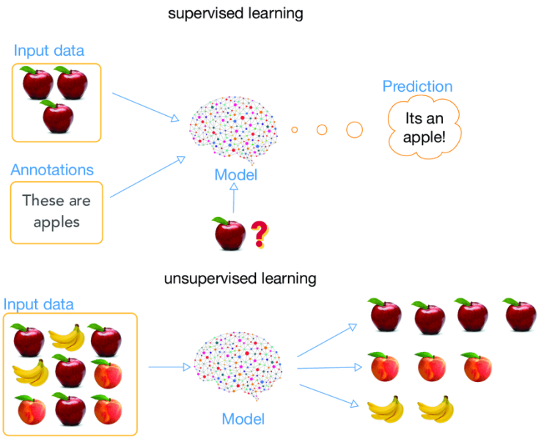

Slide 6
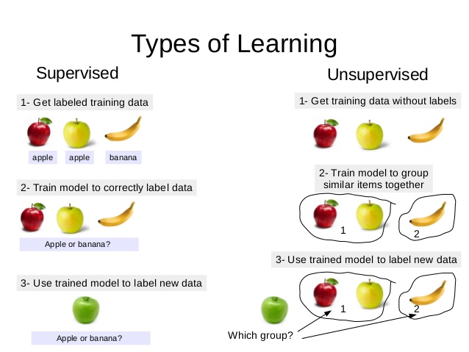

Slide 7
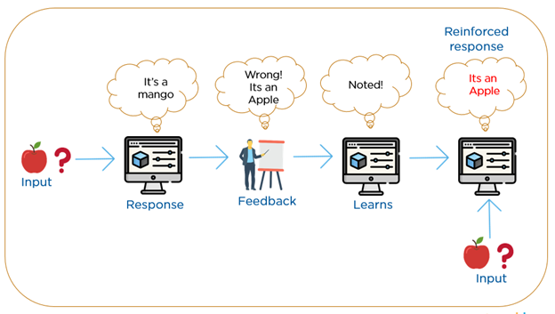

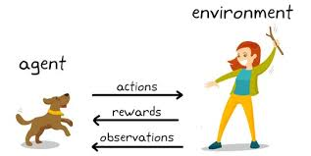
Reinforcement Learning

Slide 8
Supervised learning is a type of machine learning function that maps an input to an output based on example input-output pairs. It infers a function from labeled training data consisting of a set of training examples.
Unsupervised learning is a type of machine learning algorithm used to draw inferences from datasets consisting of input data without labeled responses. The most common unsupervised learning method is cluster analysis, which is used for examining data analysis to find hidden patterns or grouping in data.
Reinforcement learning (RL) is an area of machine learning concerned with how intelligent agents ought (to indicate duty or correctness, typically when criticizing someone's actions) to take actions in an environment in order to maximize the notion of cumulative reward.

Slide 9
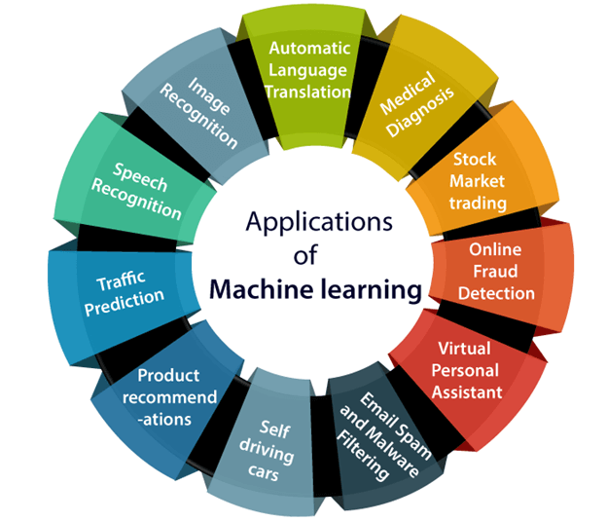

Slide 10
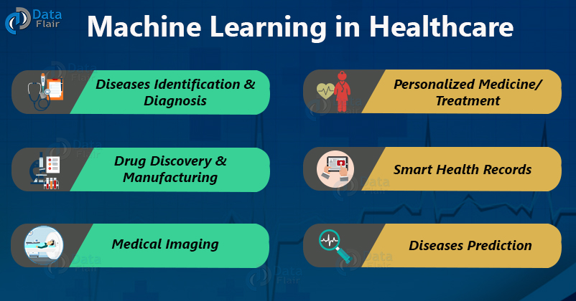

Slide 11

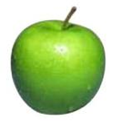
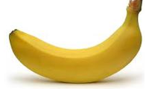
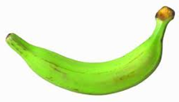
Data
examples
Data

Slide 12
Supervised learning
examples
label
label₁
label₃
labeled examples
label₄
label₅
Supervised learning: given labeled examples

Slide 13
Supervised learning
Data
Label
label₁
model/
predictor
label₃
label₄
label₅
Supervised learning: given labeled examples

Slide 14
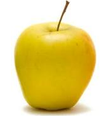
Supervised learning
model/
predictor
predicted label
Supervised learning: learn to predict new example

Slide 15
Supervised learning: classification
Data
Label
apple
Classification: a finite set of labels
apple
banana
banana

Slide 16
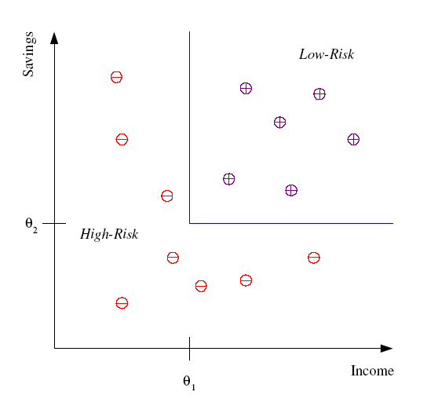
Classification Example
Classification of low-risk and high-risk customers from their income and savings

Slide 17
Classification Applications
Face recognition
Character recognition
Spam detection (unsolicited email or text messages simultaneously to a number of e-mail addresses or mobile phones)
Medical diagnosis: From symptoms to illnesses
Biometrics: Recognition / authentication using physical and/or behavioral characteristics (Face, iris, signature, etc..)

Slide 18
Supervised learning: regression
label
-4.5
Regression: label is real-valued
10.1
3.2
4.3
Supervised learning: given labeled examples

Slide 19
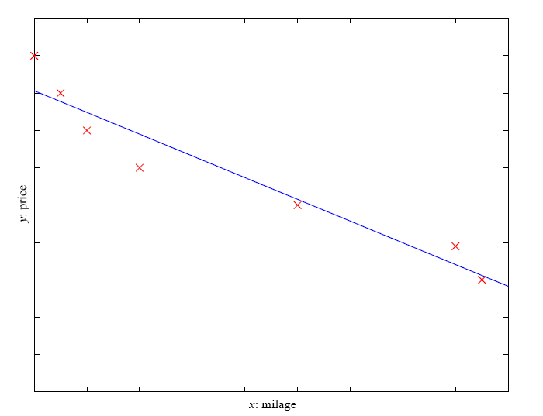
Regression Example
Price of a used car
x : car attributes (e.g. mileage)
y : price
y = wx+w₀

Slide 20
Regression Applications
Economics/Finance: predict the value of a stock
Epidemiology: study (scientific, systematic, and data-driven) of the distribution (frequency, pattern) and determinants (causes, risk factors) of health-related states and events in specified populations (neighborhood, school, city, state, country, global).
Car/Airplane navigation: angle of the steering wheel, acceleration, …
Temporal trends: represents the statistical probability of detecting a change of a given magnitude when this change actually occurs.
Ex: weather over time
Coronavirus Optimization Algorithm: A Bio-inspired Metaheuristic based on the COVID-19 Propagation Model

Slide 21
Supervised learning: Ranking
label
1
4
Ranking: label is a ranking
2
3
Supervised learning: given labeled examples

Slide 22
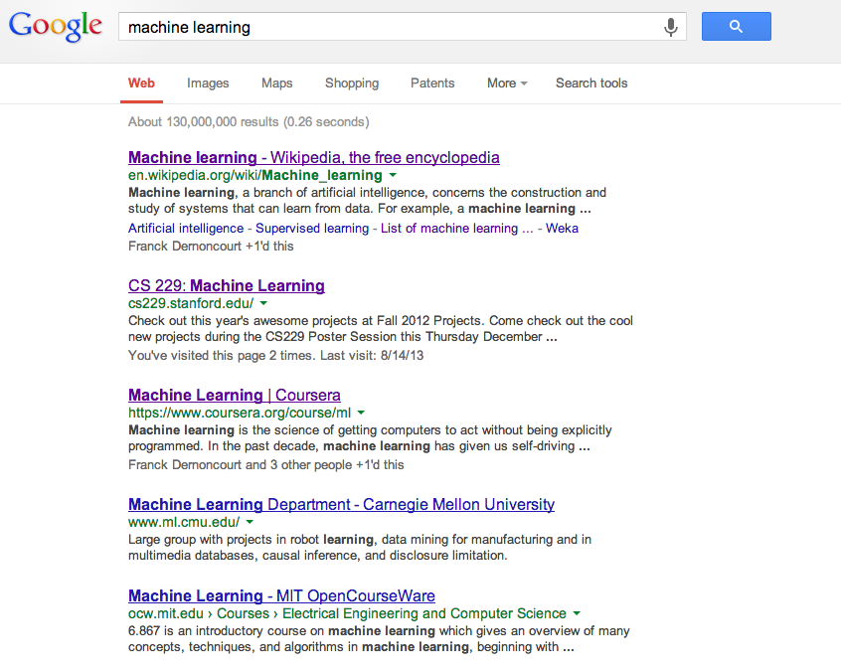
Ranking example
Given a query and a set of web pages, rank them according to relevance

Slide 23
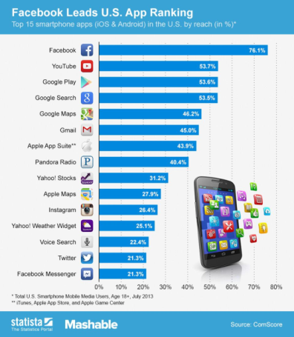
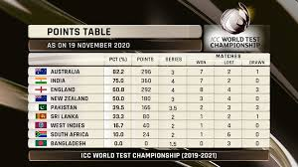
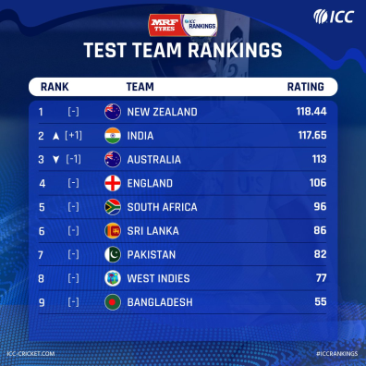
Ranking example

Slide 24

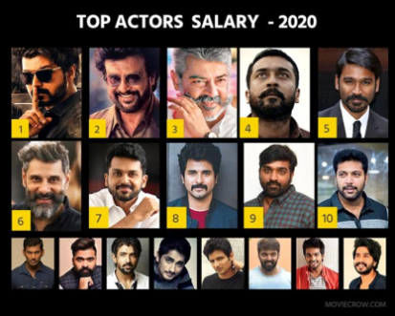
Ranking example

Slide 25
Ranking Applications
User preference: e.g. Netflix “My List” - movie queue ranking
flight search
Reranking: provide N-best output lists
final stage of a recommendation system, the system can re-rank the candidates to consider additional criteria or constraints

Slide 26
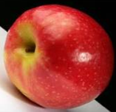
Unsupervised learning
Unupervised learning: given data, i.e. examples, but no labels

Slide 27
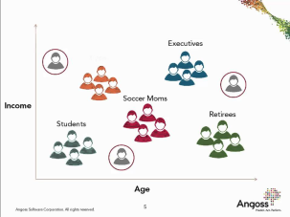

Unsupervised learning applications
Learn clusters/groups without any label
Customer segmentation (grouping)
Image compression
Bioinformatics: learn motifs (a design or figure that consists of recurring shapes or colors)

Slide 28
Reinforcement Learning
is the training of machine learning models to make a sequence of decisions. The agent learns to achieve a goal in an uncertain, potentially complex environment
It is about taking suitable action to maximize reward in a particular situation.
left, right, straight, left, left, left, straight
GOOD
left, straight, straight, left, right, straight, straight
BAD
left, right, straight, left, left, left, straight
18.5
left, straight, straight, left, right, straight, straight
-3
Given a sequence of examples/states and a reward after completing that sequence, learn to predict the action to take in for an individual example/state

Slide 29
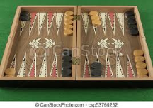
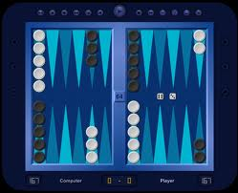
Reinforcement Learning Example
Backgammon
…
WIN!
…
LOSE!
Given sequences of moves and whether or not the player won at the end, learn to make good moves.

Slide 30
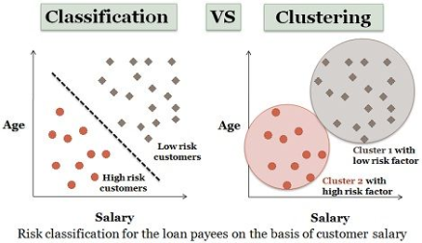
Classification Vs Clustering
Classification uses predefined classes in which objects are assigned, while clustering identifies similarities between objects, which it groups according to those characteristics in common and which differentiate them from other groups of objects. These groups are known as "clusters".

Slide 31
Classification Vs Clustering
Classification | Clustering
Supervised Learning | Unsupervised learning
This model function classifies the data into one of numerous already defined definite classes. | This function maps the data into one of the multiple clusters where the arrangement of data items is relies on the similarities between them.
Labelled data is provided. | Unlabelled data provided.

Slide 32
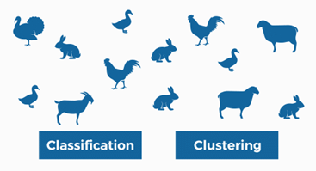
Classification Vs Clustering

Slide 33
Classification Vs Regression
Regression | Classification
Predict Continuous dependent variable based on independent variable | Predict Categorical dependent variable based on independent variable
Continuous dependent | Categorical dependent
Mean Square Estimation | Maximum likelihood estimation
Straight Line | Curve
Linear relationship between Continuous dependent variable and independent variable | Relationship between Continuous dependent variable and independent variable not mandatory
Predict Integer value | Predict Categorical value (Yes/No)
Eg. Sales forecasting | Eg. Disease detection

Slide 34
Summary…
Learning Types
Applications
Thank You…

